Slide 1
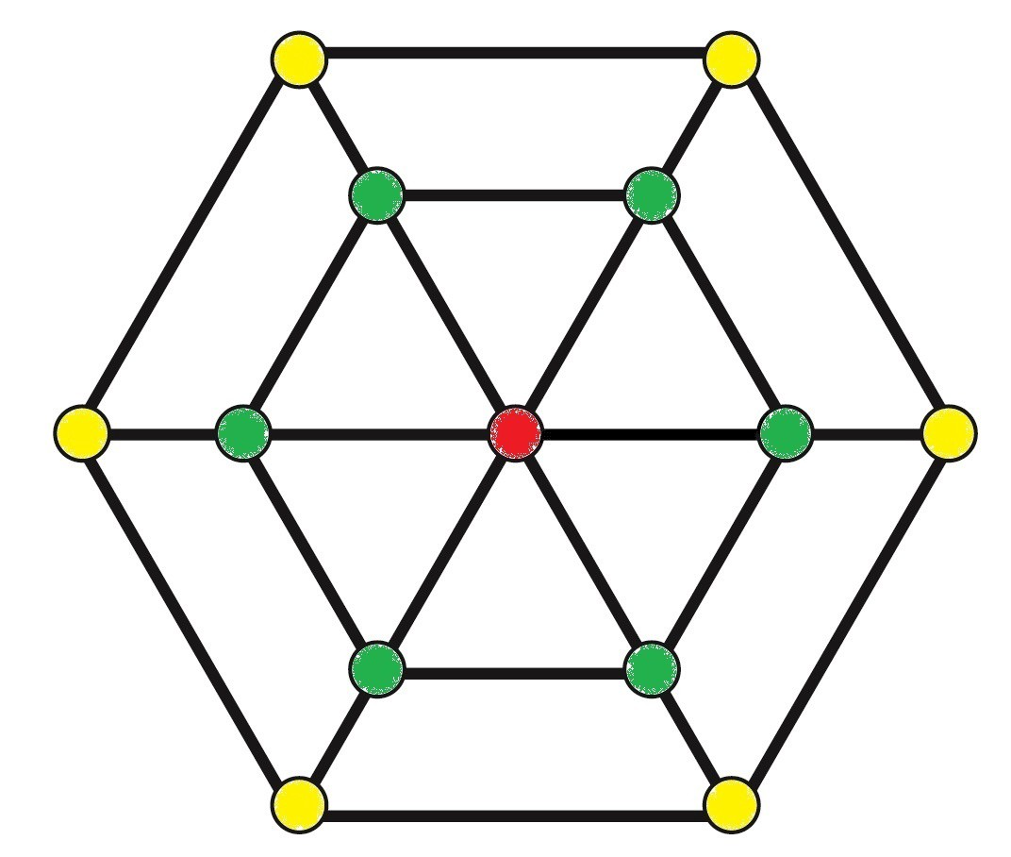
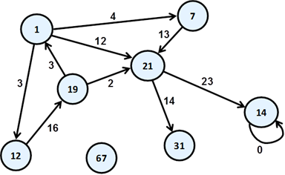
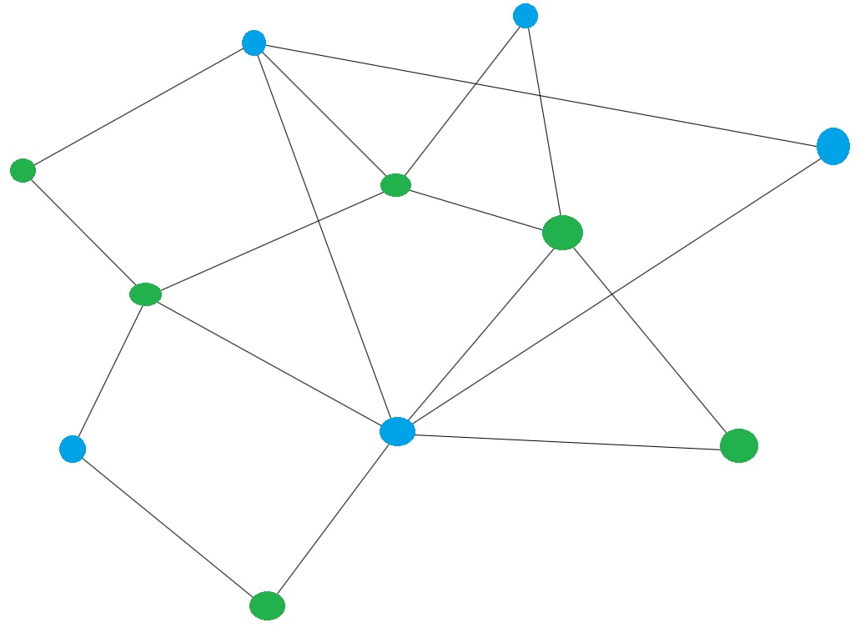
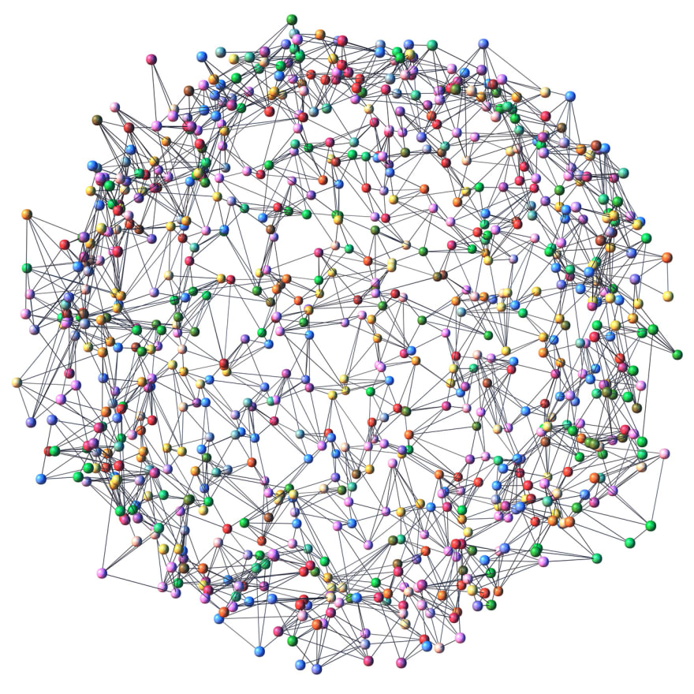
Graphs

Slide 2
Homework Review
With a peer, review Homework 5 and Exam 1

Slide 3
Trees vs Graphs
Both are composed of vertices/nodes and edges/links.
Tree: A tree is an undirected graph that is connected and has no cycles. A tree is a type of graph.
Graph: Can have cycles (but doesn't have to). Does not have to be connected.
Graphic from: https://medium.com/swlh/making-data-trees-in-python-3a3ceb050cfd

Slide 4

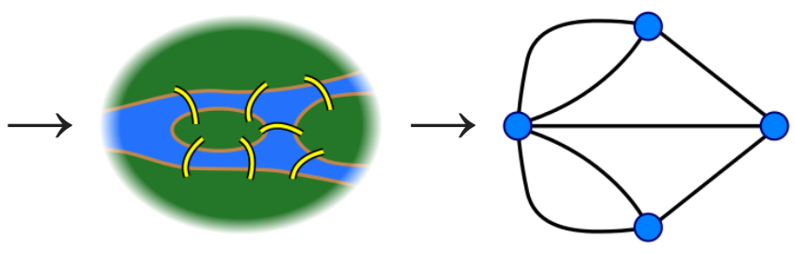
Applications of Graphs
Used to model relationships
Can represent any relation (recall reflexive, symmetric, antisymmetric, transitive)
Solve problems in many disciplines
Graph theory started when Euler solved the Seven Bridges of Konigsberg problem

Slide 5
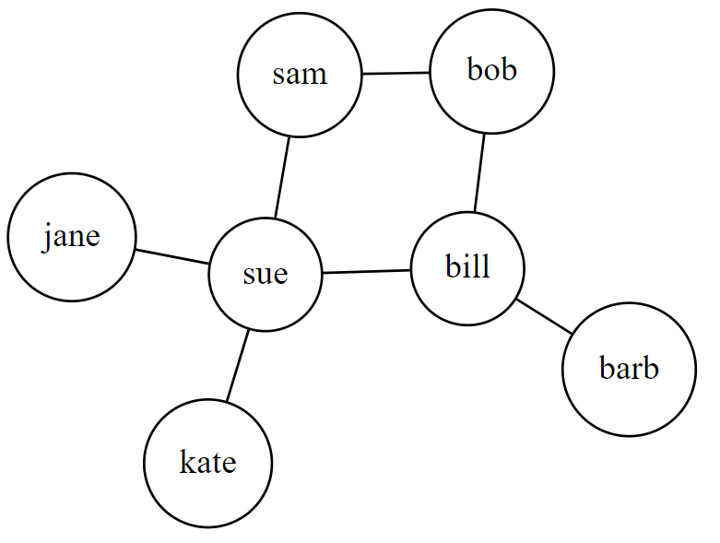
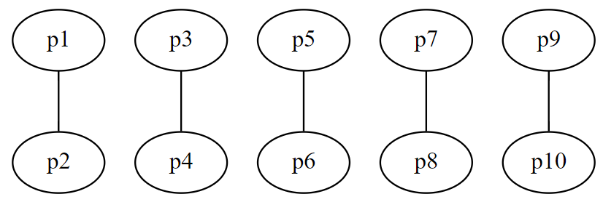
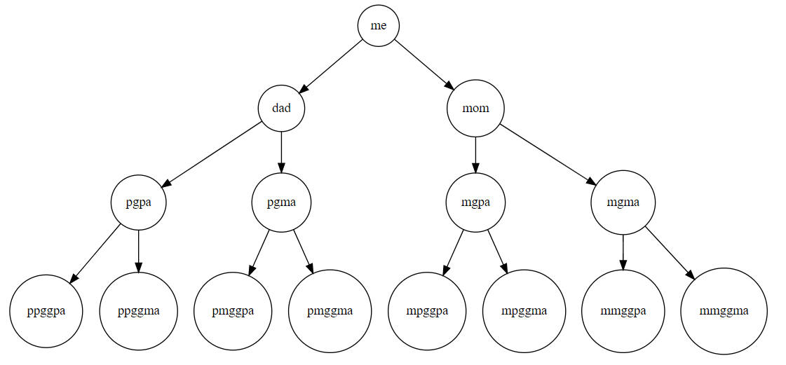
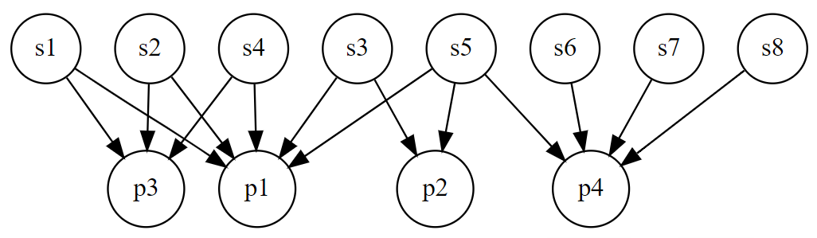
Applications of Graphs
Relationships between people
Friends in a social networking site
Marriages
Genealogical relationships
Students/Professors

Slide 6
Applications of Graphs
Scheduling problems (example: How to fit the greatest number of classes into a given schedule)
Countries that share a border
What is the fewest number of distinct frequencies needed among 10 radio stations so there is no interference?
Track winners in a tournament
Roadmaps
Can a given electrical circuit be implemented on a planar circuit board?
Model computer networks
And on and on...

Slide 7
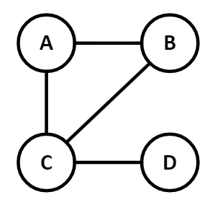
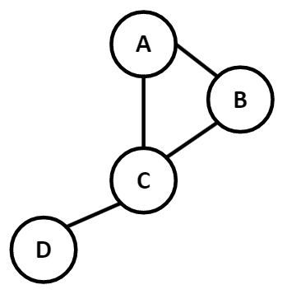

Simple Graph definition:
$G=(V,E)$ where $V$ is a nonempty set of vertices and $E$ (the edges) is a set of two-element sets (i.e., unordered pairs) of elements of $V$
Example:
$G=\left(\left\{A, B, C, D\right\}, \left\{\left\{A,B\right\}, \left\{A,C\right\}, \left\{B,C\right\}, \left\{C,D\right\}\right\}\right)$
A graph $G$ is an ordered pair consisting of a nonempty set of Vertices (Nodes) and a set of Edges (Links)
It can be helpful to draw it, but this is not necessary to be considered a graph
These both represent the same graph

Slide 8
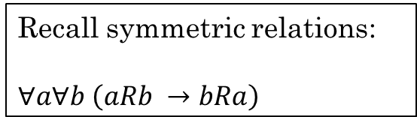
Simple Graphs:
No self-loops. Only one edge between any two vertices.
Model symmetric relations
Edges are undirected (i.e., edges represent a symmetric relation)
Any pair of objects can be related or not related
We can use a simple graph to model anything with symmetric relations
Examples:
Countries that share a border or do not share a border
Land masses connected by a bridge
Cities connected by a road
Family relationships (marriage, sibling, cousin, etc)
People that speak the same language or don't speak the same language
Classes that are taught at the same time or not taught at the same time
...
Recall symmetric relations:
$∀a∀b \left(aRb →bRa\right)$

Slide 9
Some Terms
Let G be an undirected graph and let k be an edge of G that is {u, v}.
u and v are adjacent
u and v are neighbors
u and v are connected
Edge k is incident with nodes u and v
Edge k connects u and v
Nodes u and v are the endpoints of edge k
U
k
V

Slide 10
More terms
Directed vs undirected
Node/vertex
Link/edge
Degree of a vertex
Total degree
Loop
Regular graph
D-regular graph
d
d
a
b
c
a
c
e
b
d
a
b
c
e

Slide 11
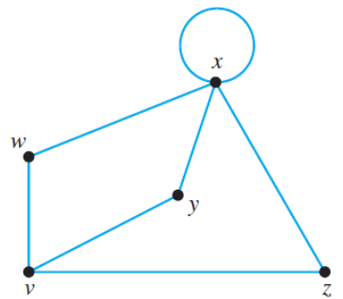
Degree Sequence
A sequence of the degrees of every node in a graph, listed in non-increasing order (highest to lowest)
What is the degree sequence of this graph?
[5,3,2,2,2]

Slide 12
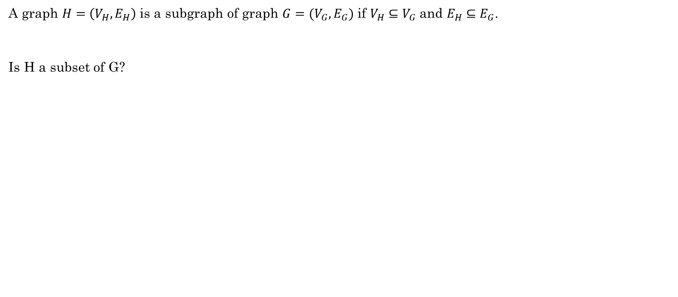
Subgraphs
A graph $H=\left(V_{H}, E_{H}\right)$ is a subgraph of graph $G=(V_{G}, E_{G})$ if $V_{H}⊆V_{G}$ and $E_{H}⊆E_{G}$.
Is H a subset of G?
d
d
a
b
c
a
b
c
H
G
e

Slide 13
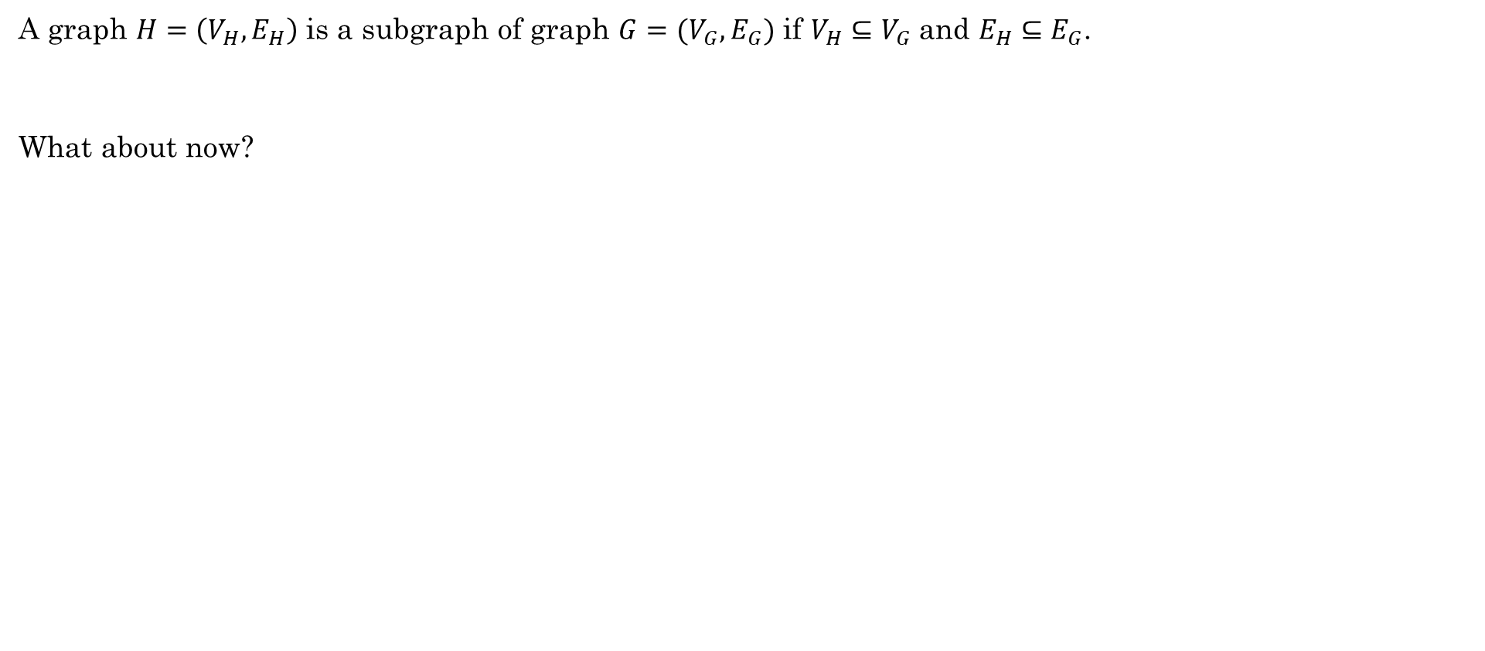
Subgraphs
A graph $H=\left(V_{H}, E_{H}\right)$ is a subgraph of graph $G=(V_{G}, E_{G})$ if $V_{H}⊆V_{G}$ and $E_{H}⊆E_{G}$.
What about now?
d
d
a
b
c
a
b
c
H
e
G
e

Slide 14
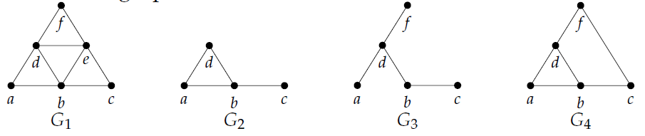
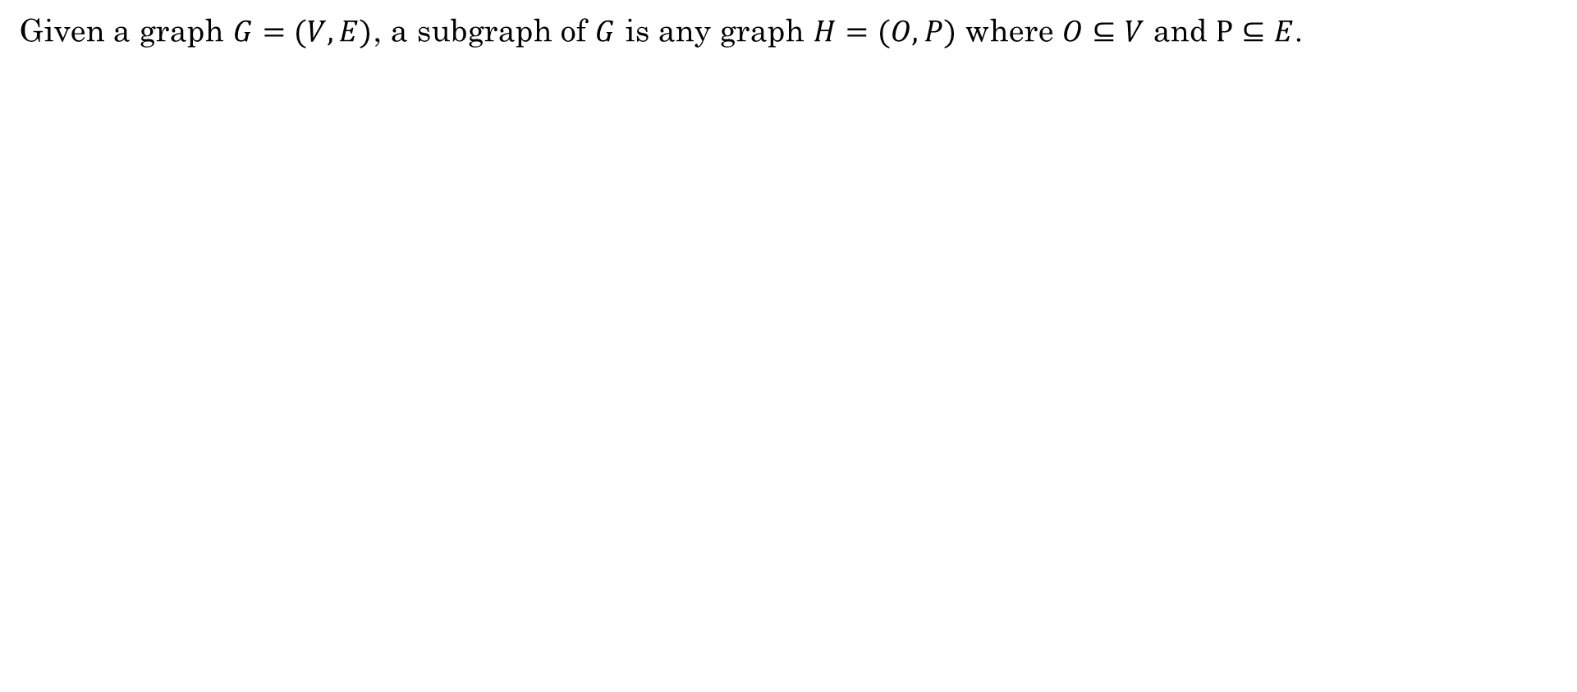


Subgraphs
Given a graph $G=(V, E)$, a subgraph of $G$ is any graph $H=(O, P)$ where $O⊆V$ and $P⊆E$.
Which of these are subgraphs of $G_{1}?$
$G_{2}$ and $G_{3}$ are both subgraphs of $G_{1}$.
$G_{4}$ is NOT a subgraph of $G_{1}$ because the link $\{c,f\}$ is not a link in $G_{1}$
Levin, Oscar. Discrete Mathematics, An Open Introduction, 3rd Edition. 2021

Slide 15
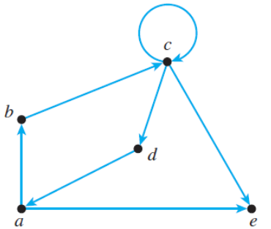
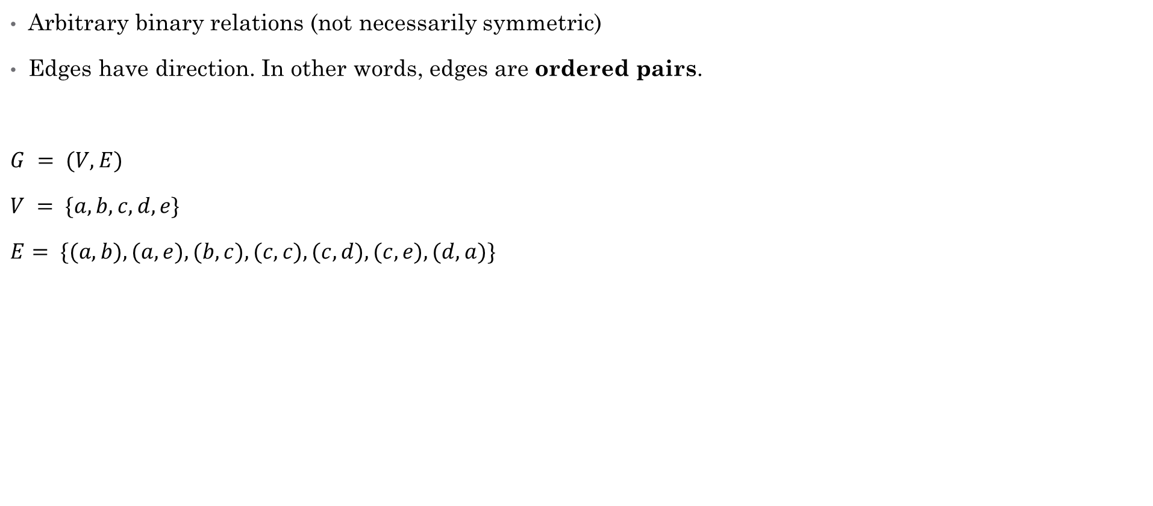
Directed Graphs (Digraphs)
Arbitrary binary relations (not necessarily symmetric)
Edges have direction. In other words, edges are ordered pairs.
$G = (V, E)$
$V = \{a,b,c,d,e\}$
$E= \{(a,b), (a,e), (b,c), (c,c), (c,d), (c,e), (d,a)\}$
Hunter, David J. Essentials of Discrete Mathematics, 3rd Edition. Jones & Bartlett Learning 2017

Slide 16
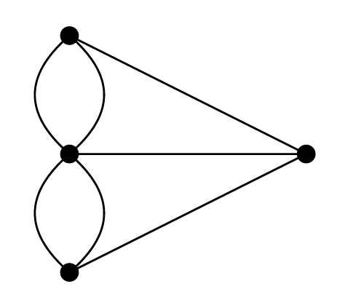
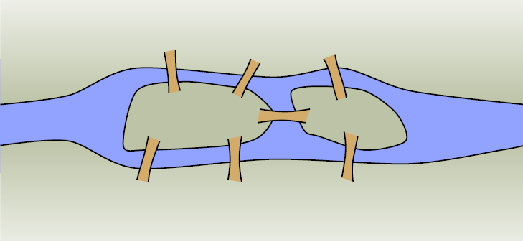
Multigraph
There may be more than one link between a pair of adjacent nodes

Slide 17
Pseudograph
One or more nodes is adjacent to itself (loops)

Slide 18
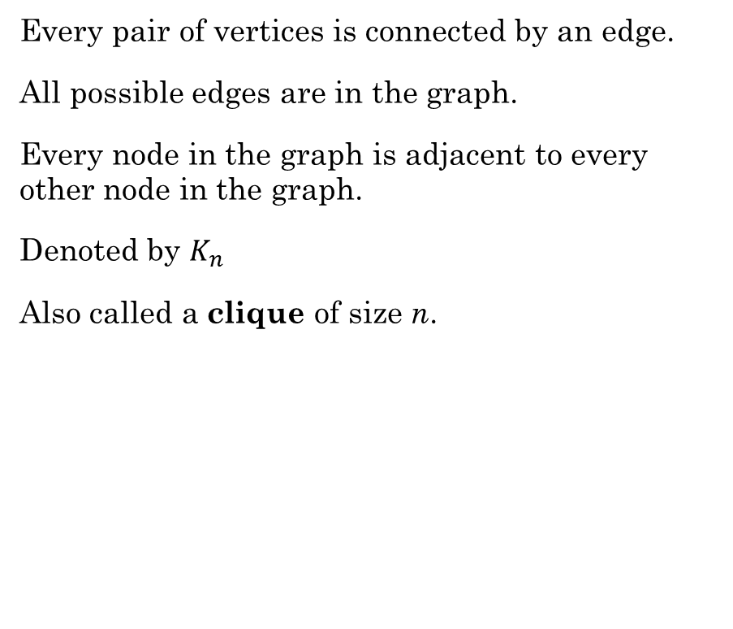
Complete Graph
Every pair of vertices is connected by an edge.
All possible edges are in the graph.
Every node in the graph is adjacent to every other node in the graph.
Denoted by $K_{n}$
Also called a clique of size n.

Slide 19
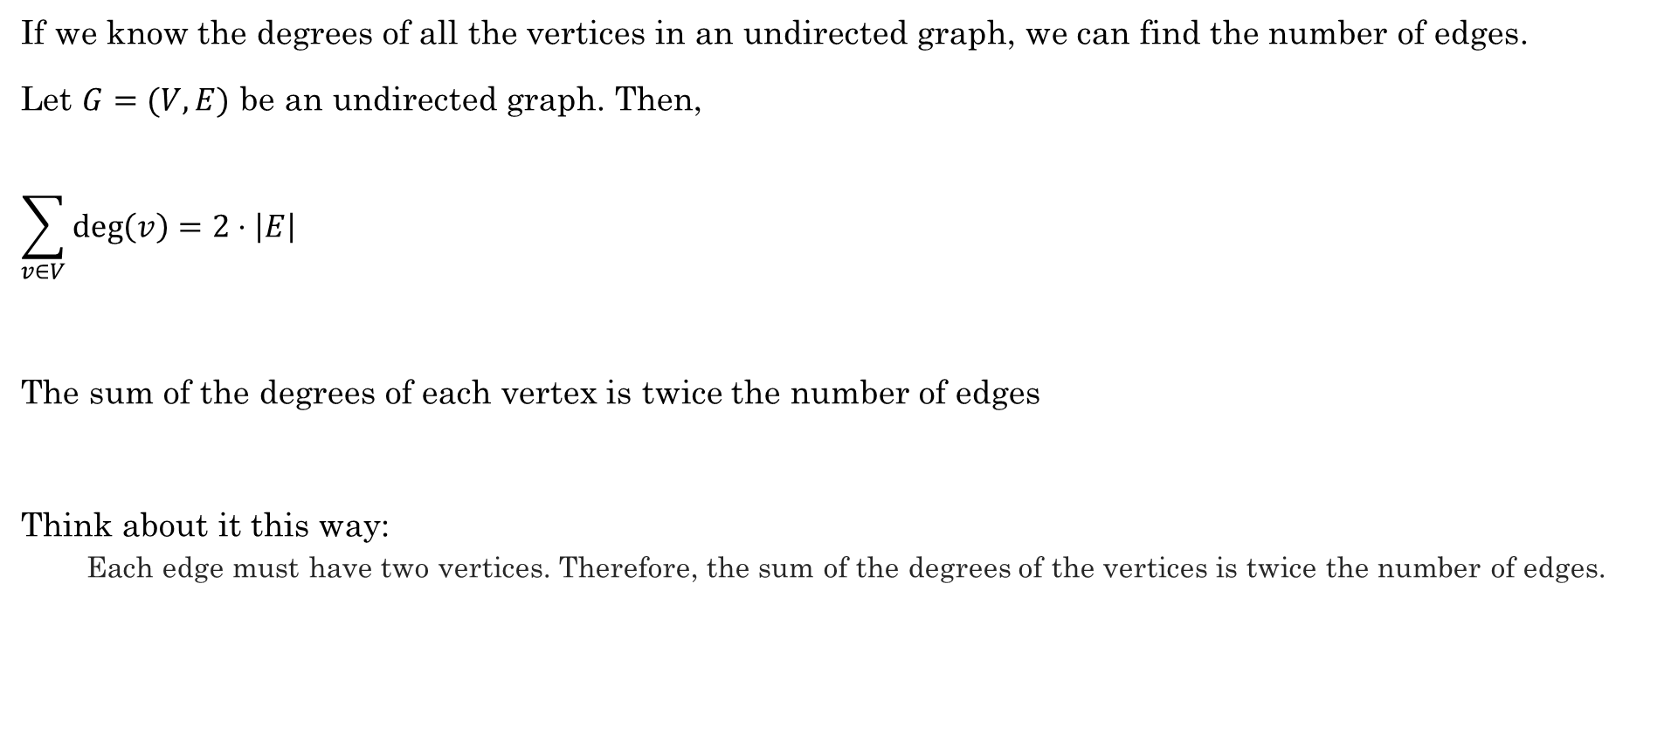
Handshaking Theorem
If we know the degrees of all the vertices in an undirected graph, we can find the number of edges.
Let $G=(V, E)$ be an undirected graph. Then,
$$\sum_{v∈V}{\deg\left(v\right)=2⋅\left|E\right|}$$
The sum of the degrees of each vertex is twice the number of edges
Think about it this way:
Each edge must have two vertices. Therefore, the sum of the degrees of the vertices is twice the number of edges.

Slide 20
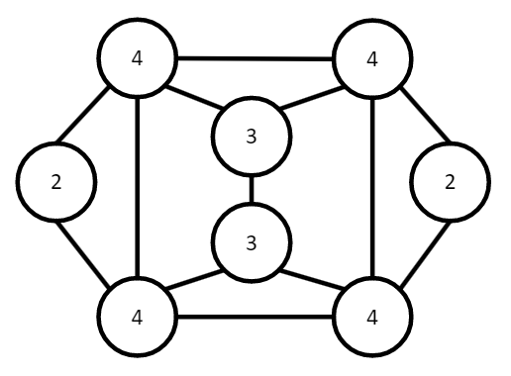

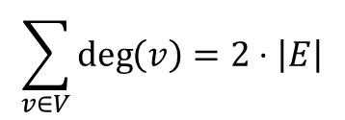

Handshaking Theorem
$$\sum_{v∈V}{\deg\left(v\right)=2⋅\left|E\right|}$$
Example:
How many edges are in the graph with the following degree sequence?
$[4,4,4,4,3,3,2,2]$
$$4+4+4+4+3+3+2+2=26$$
$\frac{26}{2}=13$ edges
Count them. Is it true?

Slide 21

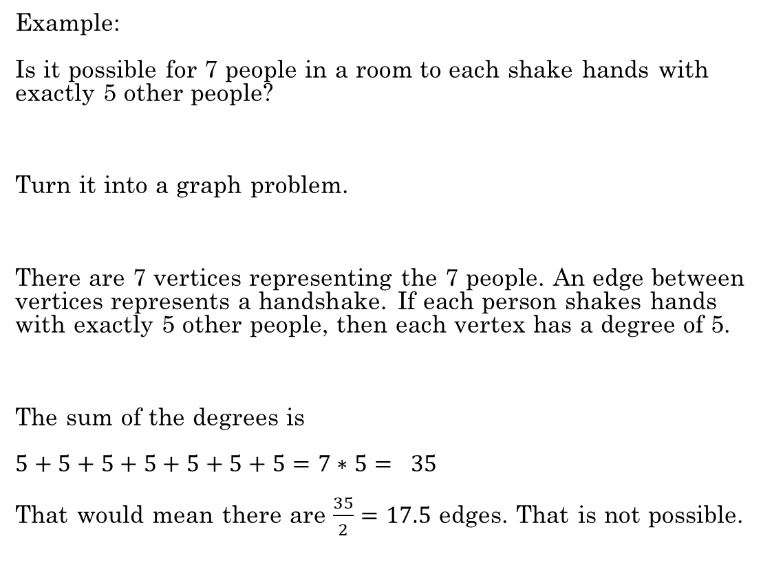
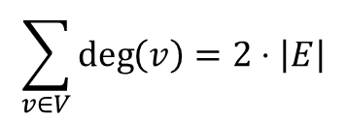
Handshaking Theorem
$$\sum_{v∈V}{\deg\left(v\right)=2⋅\left|E\right|}$$
Example:
Is it possible for 7 people in a room to each shake hands with exactly 5 other people?
Turn it into a graph problem.
There are 7 vertices representing the 7 people. An edge between vertices represents a handshake. If each person shakes hands with exactly 5 other people, then each vertex has a degree of 5.
The sum of the degrees is
$5+5+5+5+5+5+5=7∗5= 35$
That would mean there are $\frac{35}{2}=17.5$ edges. That is not possible.

Slide 22

Handshaking Theorem
$$\sum_{v∈V}{\deg\left(v\right)=2⋅\left|E\right|}$$
Try it:
Among a group of 5 people, is it possible for everyone to be friends with exactly 2 of the people in the group?
What about with exactly 3 of the people in the group?
Yes. Using a graph of 5 vertices, there are 2 edges per vertex.
There are $\frac{2∗5}{2}=5$ edges. It is possible.
No. There are $\frac{5∗3}{2}=7.5$ edges. This is not possible.
Levin, Oscar. Discrete Mathematics, An Open Introduction, 3rd Edition. 2021

Slide 23
Additional Exercises
13.1.1
13.1.3

Slide 24
Adjacency List
Represents the relationship between vertices
s | a, b
a | g,c,d
b | d
g | e
c | e
d | f
e | t
f | t
t

Slide 25
Adjacency Matrix
Represent the relationship between nodes
 | S | A | B | C | D | E | F | G | T
S |  | 1 | 1
A |  |  |  | 1 | 1 |  |  | 1
B |  |  |  |  | 1
C |  |  |  |  |  | 1
D |  |  |  |  |  |  | 1
E |  |  |  |  |  |  |  |  | 1
F |  |  |  |  |  |  |  |  | 1
G |  |  |  |  |  | 1
T

Slide 26
Try It
Create an adjacency matrix for this graph
 | 1 | 2 | 3 | 4 | 5 | 6
1 | 1 | 1 |  |  | 1
2 | 1 |  | 1 |  | 1
3 |  | 1 |  | 1
4 |  |  | 1 |  | 1 | 1
5 | 1 | 1 |  | 1
6 |  |  |  | 1
What do you notice about the symmetry of this undirected graph?

Slide 27
Additional Exercises
13.2.1
13.2.2
13.2.3 (if time)

Slide 28
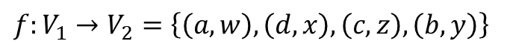
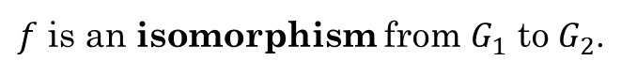
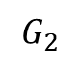
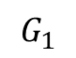
Graph Isomorphisms
Two graphs $G_{1}$ and $G_{2}$ are isomorphic if we can find a way to map the vertex sets of each graph such that there is an edge between two vertices in $G_{1}$ if and only if there is an edge between the corresponding two vertices in $G_{2}$.
In other words, we need to find a bijection function $f:V_{1}→V_{2}$ such that for every $x,y∈V_{1}$, then $\left\{x,y\right\}∈E_{1}$ if and only if $\left\{f\left(x\right), f\left(y\right)\right\}∈E_{2}$.
$$G_{1}$$
$$G_{2}$$
$f:V_{1}→V_{2}=\left\{\left(a,w\right), \left(d,x\right), \left(c,z\right), \left(b,y\right)\right\}$
a
b
w
$f$ is an isomorphism from $G_{1}$ to $G_{2}$.
x
d
c
z
y
Another way to think about it: Two graphs are isomorphic if the vertices can be relabeled so that the graphs are identical.

Slide 29
Graph Isomorphisms
Some graph properties are preserved under isomorphism.
If two graphs are isomorphic, then both have the same:
Vertex degree
Degree sequence
Anything related to the structure of the graph rather than the labels on the vertices/edges.
$$G_{1}$$
$$G_{2}$$
a
b
w
x
d
c
z
y

Slide 30
Additional Exercises:
13.3.1
13.3.2

Slide 31
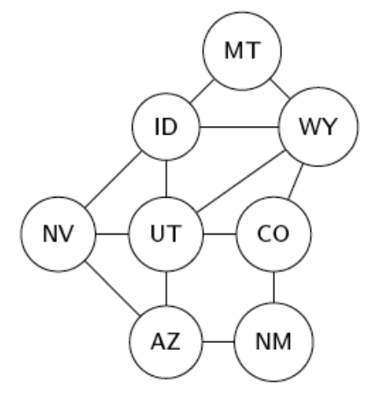
Walks
Graphs are made up of:
Vertices: ID, MT, WY, etc.
Edges: (ID,MT), (NV,ID), etc.
We represent a walk, trail, or path as a sequence of edges or as a sequence of vertices.
A trail is a sequence in which no edge occurs more than once.
A circuit is a closed sequence in which no edge occurs more than once.
A path is a trail that does not repeat vertices (which also means it does not repeat edges).
A cycle is a circuit in which no vertices are repeated, except the starting/ending vertex
Example:
A path from NV to WY:
As a sequence of Vertices: [NV, UT, WY]
As a sequence of Edges: [(NV,UT), (UT,WY)]

Slide 32
Circuit vs Cycle
A circuit is a trail from a vertex back to itself, with no repeated edges.
[(NV, ID), (ID, MT), (MT, WY), (WY, ID), (ID, UT), (UT, AZ), (AZ, NV)]
[NV, ID, MT, WY, ID, UT, AZ, NV]
A cycle is a path from a vertex back to itself, with no repeated vertices.
[(ID, MT), (MT, WY), (WY, CO), (CO, UT), (UT, AZ), (AZ, NV), (NV, ID)]
[ID, MT, WY, CO, UT, AZ, NV, ID]

Slide 33
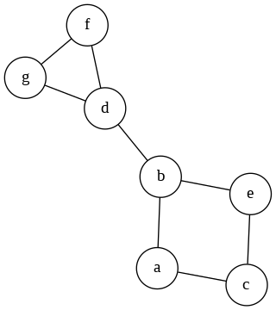
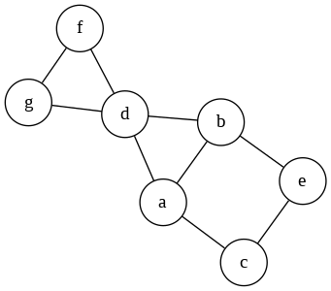
Graph Connectivity
k-vertex connectivity: The minimum number of vertices to remove so the graph is no longer connected.
k-edge connectivity: The minimum number of edges to remove so the graph is no longer connected.
What is the vertex connectivity and edge connectivity of these graphs?
1-vertex connected
1-edge connected
1-vertex connected
2-edge connected

Slide 34
Graph Connectivity
Additional exercises:
13.5.2

Slide 35
Euler Circuits
An Euler circuit is a circuit that contains every edge and every vertex.
No edges are repeated.
Seven Bridges of Königsberg
Can you find an Euler circuit in this graph?

Slide 36
Euler Circuits
What are some examples of graphs in which we would want to visit every edge once and only once?
Plowing roads (vertices are intersections and roads are edges)
Mail delivery

Slide 37
Euler Circuits
A circuit has no repeated edges.
If an undirected graph G has an Euler circuit, then G is connected and every vertex in G has an even degree.
If a graph has a vertex with an odd degree, then the graph cannot have an Euler circuit.
If an undirected graph G is connected and every vertex in G has an even degree, then G has an Euler circuit.
Try to find an Euler circuit in this graph:
An undirected graph G has an Euler circuit if and only if G is connected and every vertex in G has even degree.
Start at a.
d
If we start at a, we must end at a because it is a circuit.
a
b
c
But if we leave a, then come back to a, there is still one more edge we haven't traversed.
e
If we traverse that last edge, we are not longer ending at a, so it is not a circuit.

Slide 38
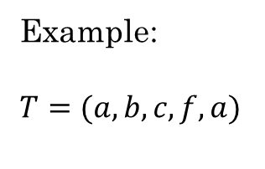
Finding a circuit in a graph
All vertices must have even degree.
Find a vertex w, that is not an isolated vertex.
Select any edge {w, x} incident to w. (Since w is not isolated, there is always at least one such edge.)
Current trail T := ⟨w, x⟩ last := x
While there is an edge {last, y} that has not been used in T: Add y to the end of T last := y
a
b
f
c
d
e
Example:
$T=(a,b,c,f,a)$

Slide 39
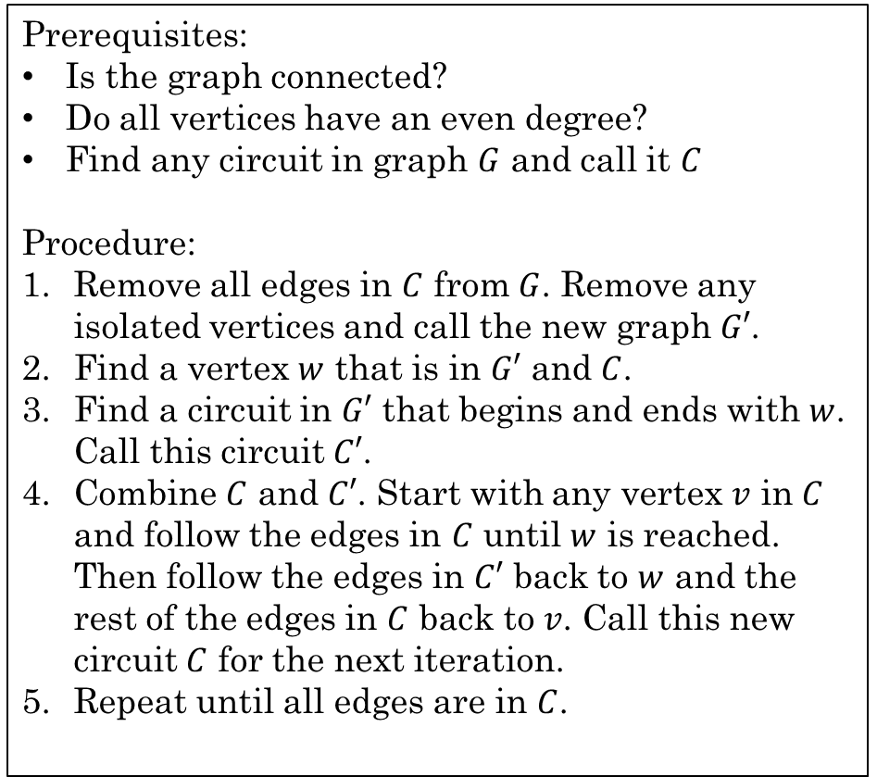
Finding an Euler Circuit in a graph
Find a Euler Circuit by tracing the algorithm in on the following graph:
Prerequisites:
Is the graph connected?
Do all vertices have an even degree?
Find any circuit in graph $G$ and call it $C$
Procedure:
Remove all edges in $C$ from $G$. Remove any isolated vertices and call the new graph $G′$.
Find a vertex $w$ that is in $G′$ and $C$.
Find a circuit in $G′$ that begins and ends with $w$. Call this circuit $C′$.
Combine $C$ and $C′$. Start with any vertex $v$ in $C$ and follow the edges in $C$ until $w$ is reached. Then follow the edges in $C′$ back to $w$ and the rest of the edges in $C$ back to $v$. Call this new circuit $C$ for the next iteration.
Repeat until all edges are in $C$.
a
b
c
d
e

Slide 40
Finding an Euler Circuit in a graph
Find a Euler Circuit by tracing the algorithm in on the following graph:
Prerequisites:
Is the graph connected?
Do all vertices have an even degree?
Find any circuit in graph $G$ and call it $C$
Procedure:
Remove all edges in $C$ from $G$. Remove any isolated vertices and call the new graph $G′$.
Find a vertex $w$ that is in $G′$ and $C$.
Find a circuit in $G′$ that begins and ends with $w$. Call this circuit $C′$.
Combine $C$ and $C′$. Start with any vertex $v$ in $C$ and follow the edges in $C$ until $w$ is reached. Then follow the edges in $C′$ back to $w$ and the rest of the edges in $C$ back to $v$. Call this new circuit $C$ for the next iteration.
Repeat until all edges are in $C$.
a
b
c
d
e
C = (a, b, c, a)

Slide 41
Finding an Euler Circuit in a graph
Find a Euler Circuit by tracing the algorithm in on the following graph:
Prerequisites:
Is the graph connected?
Do all vertices have an even degree?
Find any circuit in graph $G$ and call it $C$
Procedure:
Remove all edges in $C$ from $G$. Remove any isolated vertices and call the new graph $G′$.
Find a vertex $w$ that is in $G′$ and $C$.
Find a circuit in $G′$ that begins and ends with $w$. Call this circuit $C′$.
Combine $C$ and $C′$. Start with any vertex $v$ in $C$ and follow the edges in $C$ until $w$ is reached. Then follow the edges in $C′$ back to $w$ and the rest of the edges in $C$ back to $v$. Call this new circuit $C$ for the next iteration.
Repeat until all edges are in $C$.
a
b
c
d
e
C = (a, b, c, a)
C' = (a, d, e, a)

Slide 42
Finding an Euler Circuit in a graph
Find a Euler Circuit by tracing the algorithm in on the following graph:
Prerequisites:
Is the graph connected?
Do all vertices have an even degree?
Find any circuit in graph $G$ and call it $C$
Procedure:
Remove all edges in $C$ from $G$. Remove any isolated vertices and call the new graph $G′$.
Find a vertex $w$ that is in $G′$ and $C$.
Find a circuit in $G′$ that begins and ends with $w$. Call this circuit $C′$.
Combine $C$ and $C′$. Start with any vertex $v$ in $C$ and follow the edges in $C$ until $w$ is reached. Then follow the edges in $C′$ back to $w$ and the rest of the edges in $C$ back to $v$. Call this new circuit $C$ for the next iteration.
Repeat until all edges are in $C$.
a
b
c
d
e
C = (a, b, c, a)
C = (a, d, e, a, b, c, a)
C' = (a, d, e, a)

Slide 43
Finding an Euler Circuit in a graph
Find a Euler Circuit by tracing the algorithm in on the following graph:
Prerequisites:
Is the graph connected?
Do all vertices have an even degree?
Find any circuit in graph $G$ and call it $C$
Procedure:
Remove all edges in $C$ from $G$. Remove any isolated vertices and call the new graph $G′$.
Find a vertex $w$ that is in $G′$ and $C$.
Find a circuit in $G′$ that begins and ends with $w$. Call this circuit $C′$.
Combine $C$ and $C′$. Start with any vertex $v$ in $C$ and follow the edges in $C$ until $w$ is reached. Then follow the edges in $C′$ back to $w$ and the rest of the edges in $C$ back to $v$. Call this new circuit $C$ for the next iteration.
Repeat until all edges are in $C$.
a
b
c
d
e
C = (a, d, e, a, b, c, a)

Slide 44
Finding an Euler Circuit in a graph
Find a Euler Circuit by tracing the algorithm in on the following graph:
Prerequisites:
Is the graph connected?
Do all vertices have an even degree?
Find any circuit in graph $G$ and call it $C$
Procedure:
Remove all edges in $C$ from $G$. Remove any isolated vertices and call the new graph $G′$.
Find a vertex $w$ that is in $G′$ and $C$.
Find a circuit in $G′$ that begins and ends with $w$. Call this circuit $C′$.
Combine $C$ and $C′$. Start with any vertex $v$ in $C$ and follow the edges in $C$ until $w$ is reached. Then follow the edges in $C′$ back to $w$ and the rest of the edges in $C$ back to $v$. Call this new circuit $C$ for the next iteration.
Repeat until all edges are in $C$.
a
b
c
d
e
C = (a, d, e, a, b, c, a)
C' = (b, d, c, e, b)

Slide 45
Finding an Euler Circuit in a graph
Find a Euler Circuit by tracing the algorithm in on the following graph:
Prerequisites:
Is the graph connected?
Do all vertices have an even degree?
Find any circuit in graph $G$ and call it $C$
Procedure:
Remove all edges in $C$ from $G$. Remove any isolated vertices and call the new graph $G′$.
Find a vertex $w$ that is in $G′$ and $C$.
Find a circuit in $G′$ that begins and ends with $w$. Call this circuit $C′$.
Combine $C$ and $C′$. Start with any vertex $v$ in $C$ and follow the edges in $C$ until $w$ is reached. Then follow the edges in $C′$ back to $w$ and the rest of the edges in $C$ back to $v$. Call this new circuit $C$ for the next iteration.
Repeat until all edges are in $C$.
a
b
c
d
e
C = (a, d, e, a, b, c, a)
C' = (b, d, c, e, b)
C = (a, d, e, a, b, d, c, e, b, c, a)

Slide 46
Finding an Euler Circuit in a graph
Find a Euler Circuit by tracing the algorithm in on the following graph:
Prerequisites:
Is the graph connected?
Do all vertices have an even degree?
Find any circuit in graph $G$ and call it $C$
Procedure:
Remove all edges in $C$ from $G$. Remove any isolated vertices and call the new graph $G′$.
Find a vertex $w$ that is in $G′$ and $C$.
Find a circuit in $G′$ that begins and ends with $w$. Call this circuit $C′$.
Combine $C$ and $C′$. Start with any vertex $v$ in $C$ and follow the edges in $C$ until $w$ is reached. Then follow the edges in $C′$ back to $w$ and the rest of the edges in $C$ back to $v$. Call this new circuit $C$ for the next iteration.
Repeat until all edges are in $C$.
a
b
c
d
e
C = (a, d, e, a, b, d, c, e, b, c, a)

Slide 47
With a partner, do Additional Exercises
13.6.1 a, b, c

Slide 48
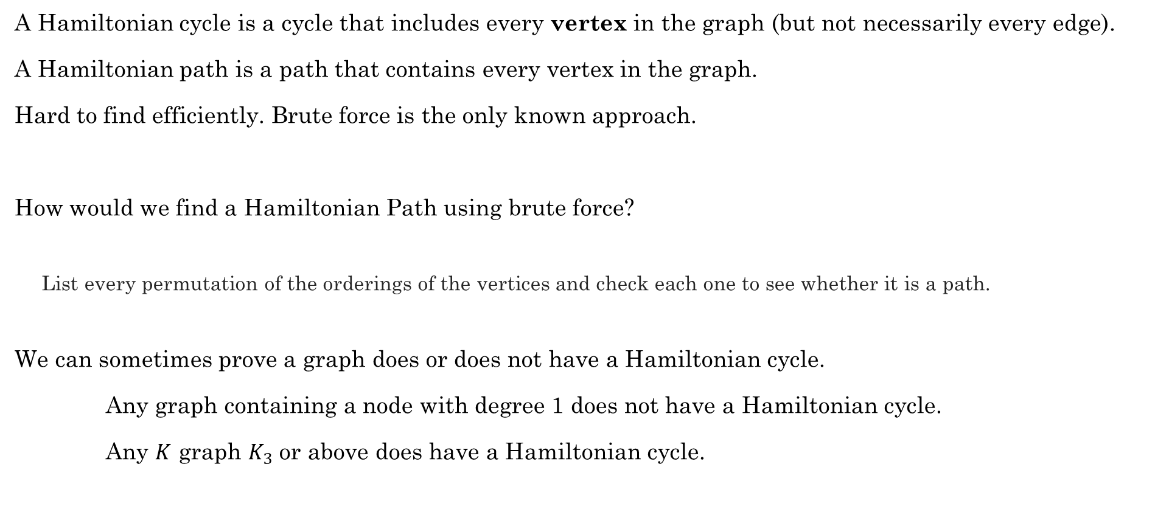
Hamiltonian Cycles
A cycle has no repeated edges or vertices.
A Hamiltonian cycle is a cycle that includes every vertex in the graph (but not necessarily every edge).
A Hamiltonian path is a path that contains every vertex in the graph.
Hard to find efficiently. Brute force is the only known approach.
How would we find a Hamiltonian Path using brute force?
List every permutation of the orderings of the vertices and check each one to see whether it is a path.
We can sometimes prove a graph does or does not have a Hamiltonian cycle.
Any graph containing a node with degree 1 does not have a Hamiltonian cycle.
Any $K$ graph $K_{3}$ or above does have a Hamiltonian cycle.

Slide 49
Hamiltonian Cycles
What are some situations in which this would be useful?
UPS delivery. Stops are the vertices and edges are the roads (Don't need to visit every edge, but we do need to visit every vertex)
Traveling Salesman. The salesman wants to visit every city and get back home.

Slide 50
With a partner:
Do additional exercise 13.7.1 and 13.7.2

Slide 51
Bipartite Graph
The graph consists of two sub-graphs. Each element of each subgraph has adjacent nodes ONLY in the other sub-graph

Slide 52
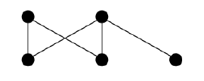
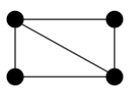
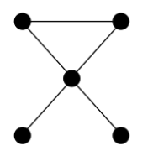
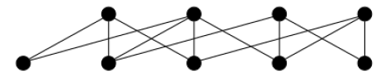
Bipartite Graphs
Can be divided into two sets of vertices such that none of the vertices in either set are connected by an edge
Example:
Bipartite
Not Bipartite

Slide 53
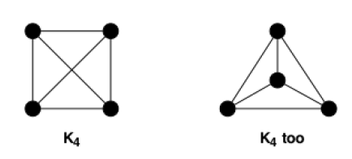
Planar Graphs
A graph that can be drawn without lines crossing
Planar?
Planar?
Note these are the same graph, just drawn differently

Slide 54
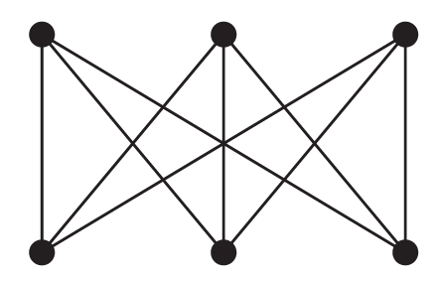


Planar Graphs
Example:
Is it possible to connect three houses to three utilities (e.g., electricity, fiber, gas) without the lines crossing?
Can you draw $K_{3,3}$ as a planar graph?
No, $K_{3,3}$ is not planar.
Levin, Oscar. Discrete Mathematics, An Open Introduction, 3rd Edition. 2021

Slide 55
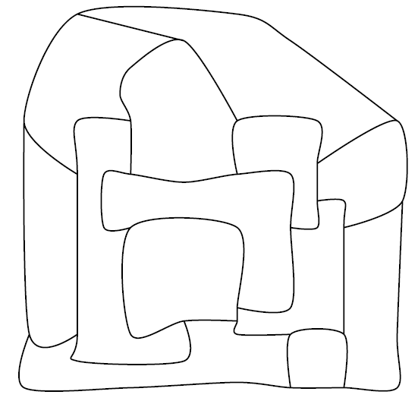
Coloring Graphs
Mapmakers in the fictional land of Euleria have drawn the borders of the various dukedoms of the land.
To make the map pretty, they wish to color each region. Adjacent regions must be colored differently, but it is perfectly fine to color two distant regions with the same color.
What is the fewest colors the mapmakers can use and still accomplish this task?
Levin, Oscar. Discrete Mathematics, An Open Introduction, 3rd Edition. 2021

Slide 56
Coloring Graphs
Mapmakers in the fictional land of Euleria have drawn the borders of the various dukedoms of the land.
To make the map pretty, they wish to color each region. Adjacent regions must be colored differently, but it is perfectly fine to color two distant regions with the same color.
What is the fewest colors the mapmakers can use and still accomplish this task?
A
B
C
D
G
J
F
E
H
K
L
I
M
Levin, Oscar. Discrete Mathematics, An Open Introduction, 3rd Edition. 2021

Slide 57
Coloring Graphs
A
B
A
B
C
D
G
C
J
J
E
D
F
G
E
F
H
K
L
L
H
K
I
M
M
I
Levin, Oscar. Discrete Mathematics, An Open Introduction, 3rd Edition. 2021

Slide 58
Coloring Graphs
Let's color the nodes using the greedy algorithm,
in alphabetical order.
B
B
A
B
A
A
C
C
D
G
C
J
J
J
D
E
D
E
G
F
G
E
F
F
L
H
K
L
L
K
H
K
H
I
M
M
I
M
I
Levin, Oscar. Discrete Mathematics, An Open Introduction, 3rd Edition. 2021

Slide 59
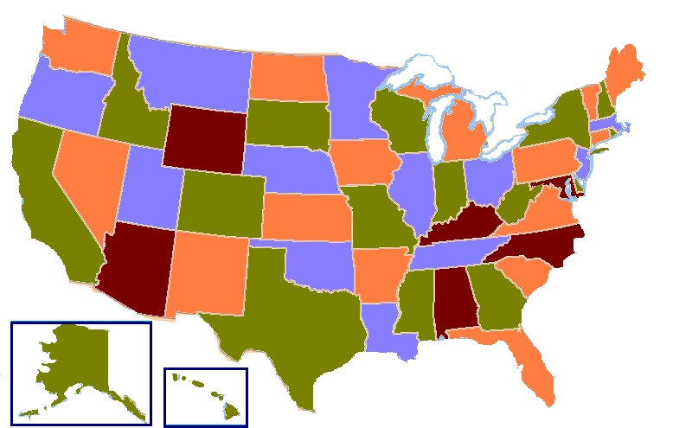

Coloring Graphs
The Four Color Theorem (proved in 1976), states that if a graph $G$ is planar, then its regions can be colored using 4 or fewer colors.
The current best proof requires computers to check 633 reducible configurations....not an easy proof.
Levin, Oscar. Discrete Mathematics, An Open Introduction, 3rd Edition. 2021

Slide 60
Additional exercises
13.9.1

Slide 61
Ramsey Theory
Studies the conditions under which order must appear
Complete disorder is impossible. There is order in chaos given a large enough set.
In graph form: Given a large enough complete graph, if we color the edges with two colors, we are guaranteed to find a monochromatic complete sub-graph of any size.
For example:
What is the minimum number of people in a group such that at least three of them are either acquainted or not acquainted?

Slide 62
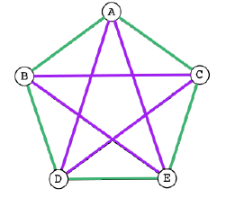
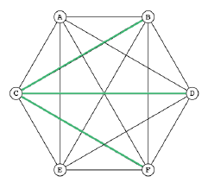
Ramsey Theory
If we color the edges of a graph using two different colors, can we do it without creating a monochromatic triangle?

Slide 63
Bipartite Graphs
Can be used to model applications that involve matching elements of one set to elements of another
Example:
Customers and Products
Employees to job assignments
Students to classes
Marriages between men and women in a village

Slide 64
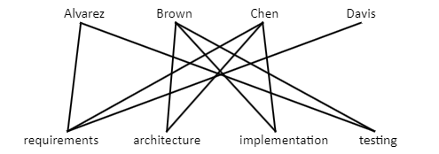
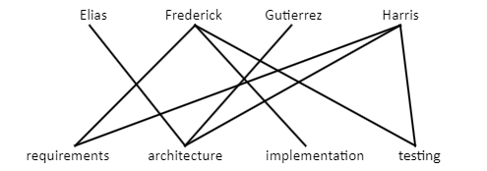

Bipartite Graphs
Example:
Assigning jobs to employees
Suppose there are $m$ employees and $n$ different jobs that need to be done where $m≥n$. Each employee is trained to do one or more of these $n$ jobs. We can use a graph to help assign employees to jobs for which they are trained.
Rosen, Kenneth. Discrete Mathematics and Its Applications, 7th Edition. McGraw-Hill, 2012

Slide 65

Bipartite Graphs
Prove whether each is bipartite or not:
$C_{3}, C_{4},C_{5},C_{6},C_{7}$
$K_{4}$

